Slide 1
CDS Customized Dashboard
Ryan Chen
R&D IOT Center Software Engineer

Slide 2

Agenda
Pre-request
Understand Call Flow
Restful API
Web App Sample

Slide 3

Pre-request
 | Task | Example
1 | Offer your App Domain (Allow Domain) to CDS Hoster | Dev.mydashboard.net Mydashboard.net
2 | Get API Authentication Key from CDS Hoster | GTRjZDIYWYtNzlmTS00..3MjU0Njdi
3 | Get API Document from CDS Hoster
4 | Get Sample Code from GitHub | Git clone https://github.com/MSIoT/CDS-CustomizedDashboard-Sample.git

Slide 4

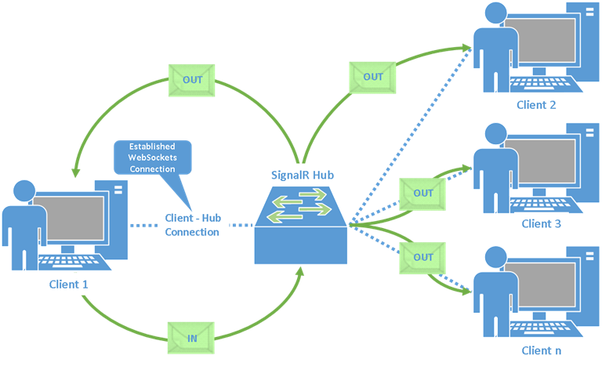
Understand Call Flow
CDS Service
Customized Dashboard
Use Authentication Key to access API
Meta Data
Return Json
Register to SignalR Hub (Allow Domain )
Realtime Data
Push Realtime message

Slide 5
Restful API

Slide 6

CDS External API
Use POSTMAN to test API

Slide 7
Web App Sample

Slide 8
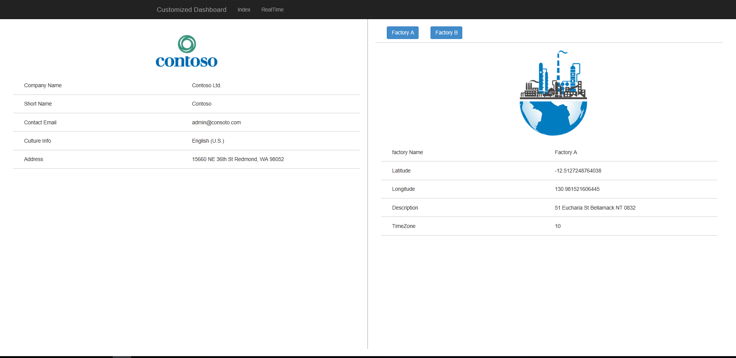
Web App Sample – Meta Data

Slide 9
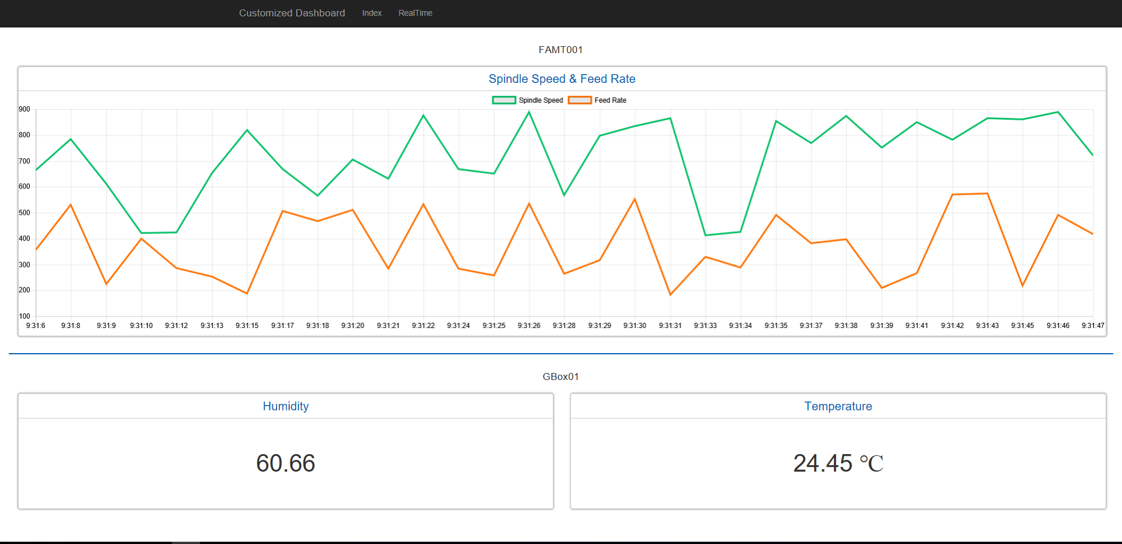
Web App Sample – Realtime Data

Slide 10
Thank You
Q&A

